Slide 1

Network Traffic DDoS Prediction
CIS 5560 Term Project Group 1
BY:-
Vraj Mehalana
Fereshteh Mamaghani
Pallavi Jindal

Slide 2
RUBRICS
Rubrics for Term Project Presentation, Term Paper, and Tutorial
Team Presentation Rubric: 100%
1. Presentation Slide Format: 20%
a. Font Size (at least 24 font size): 6%
b. Data Size (should be at least 2GB; or need permission to get full credit): 5%
c. Data Source: 4%
d. H/W experimental Specifications: 5%
2. Originality: 20%
a. How unique your idea (10%)
b. and your deliverable with code, data, markdown in your github (10%)
3. The completeness and Relevance with the topic in the class: 45%
a. Github that includes markdown page, your ipynb (or json) file, presentation slide (Azure ML link), Term Paper, data set: 8%
b. Implementation in Azure ML and Spark ML: 5%
c. Adopt at least three ML algorithms (Total 6 at least) to build models in both Spark and Azure ML: 8%
d. Completeness of Modeling, Training, Testing, Evaluation with Cross Validation and TrainValidationSplit: 9%
e. Calculate Accuracy (RMSE or Recall/Precision/AUR) and how accurate the best model is: 7%
f. List which columns mostly affect the accuracy: you can use the module “Permutation Feature Importance” in Azure ML: 3%
g. It requires table(s) that compare the result of the models (5%).
4. Communicate with the instructor about the topic to get approval to start the topic: 15%
NOTE:
1. Peer Evaluation (Optional): You have to email to the instructor the peer evaluation about your team
members for the term project and the presentation. It should be composed of:
Section #, Group name, Your Name, Team Member Name, Team Member’s role, Team Members’ Scores
out of 100%, The reason you evaluate the member(s) with the score(s).
If you don’t email me peer evaluation, I assume, all of you contribute the work fairly well.
For example, your team score is 95% and your peer evaluation by your team members are 100%, your score is 95 (= 95 x 100%)
2. Plagiarism: If you make a copy of others, it should violate the academic integrity so that you should get 0 in the term project or F in the course in the worst case.

Slide 3
Pallavi – Introduction
Fereshteh -
Vraj -

Slide 4

INTRODUCTION

Slide 5
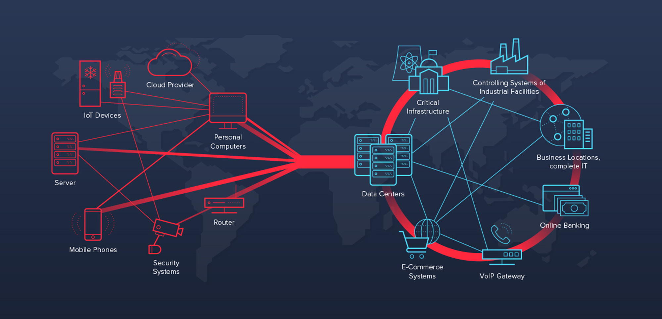
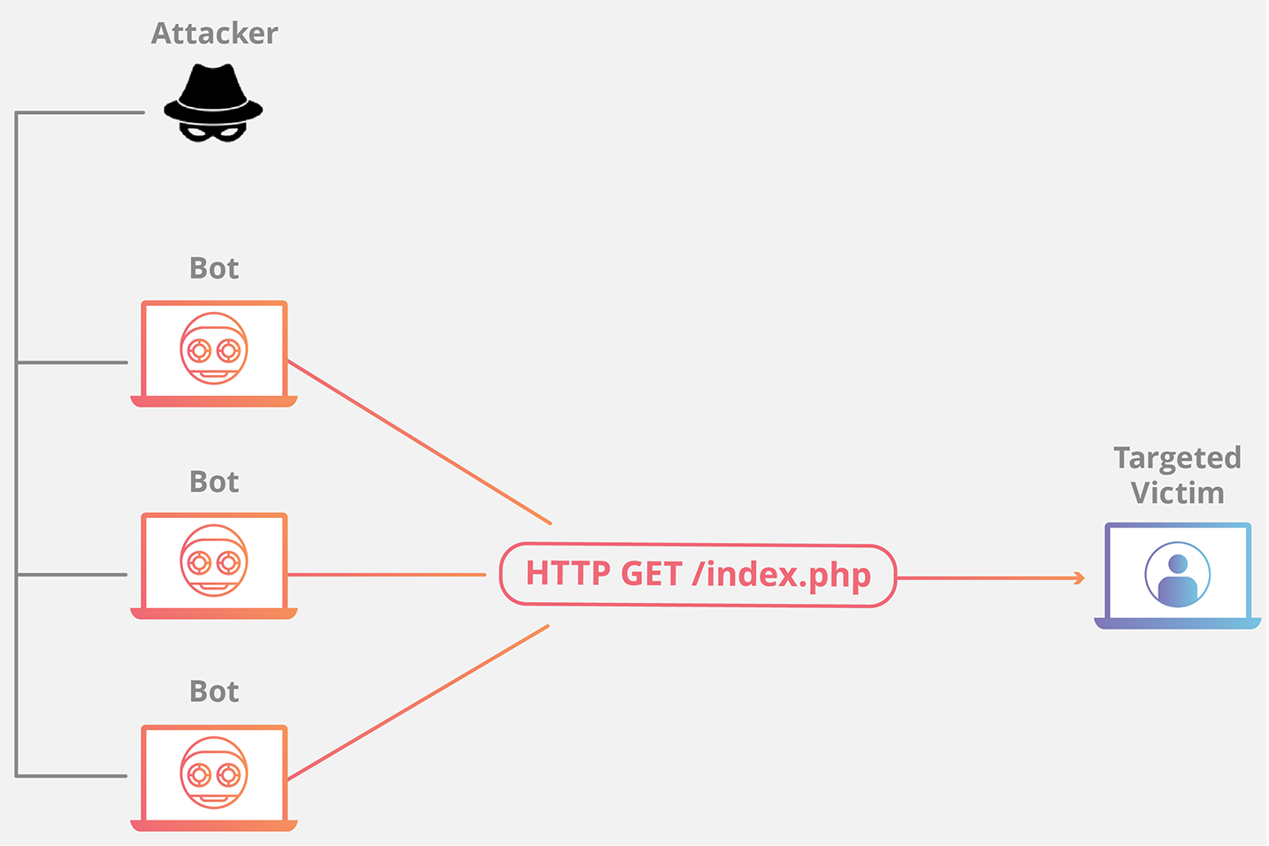
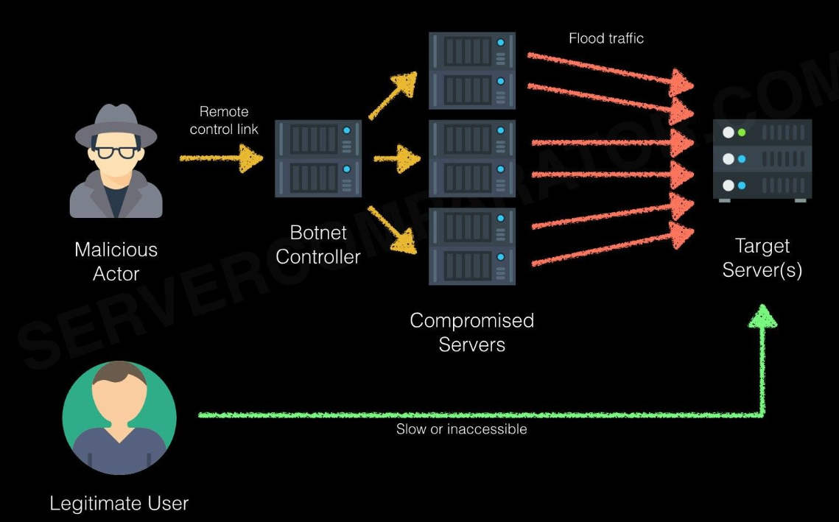
DisTributed Denial of Service
https://techcommunity.microsoft.com/t5/sql-server-blog/understanding-server-traffic-logs-and-detecting-denial-of/ba-p/385529
Notes:
Recent increase in the attacks on the application layer Denial of Service (DoS) on the Internet has caught the attention of researchers traditionally focused on network-based DoS attacks. Application layer DoS attacks are generally seen in high-volume or low-volume variations.
To solve these drawbacks, a scientific approach has been formulated to prepare the datasets for research, testing, and evaluation of intrusion detection systems, with an emphasis on network-based anomaly detectors.
The High Orbit Ion Cannon or HOIC is a network stress testing and denial-of-service (DDOS) attack application that has been written in BASIC and is designed to attack as many as 256 URLs at an analogous time. It has been designed to change the Low Orbit Ion Cannon, developed by Praetox Technologies. The free HOIC tool was wont to conduct a DDoS attack by using four different computers during this scenario.

Slide 6
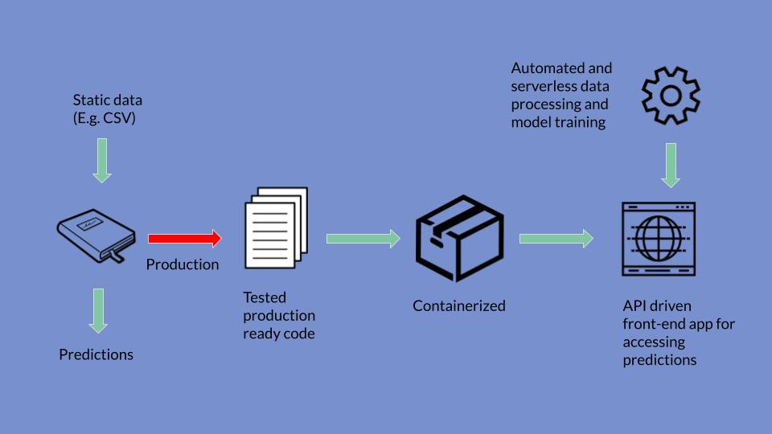
ABOUT THE PROJECT
Notes:
A flow model may be perceived as a bird’s-eye picture of the work domain, its components, and interconnections among them. It’s a high-level view of how users in each work role and other system entities interact and communicate to accomplish the work. A flow model is particularly about how work gets handed off between roles; the places where things are possible to disdain. As Beyer and Holtzblatt (1997, p. 236) put it: “The system’s job is to convey context between roles.”
The flow model, at its base, maybe a simple graphical representation of how information and artifacts flow through the system as it is made use of. It’s essential to recognize the fundamental system flow as early in usage research as possible. A flow model gives you an outline of how information, artifacts, and work products flow among user work roles and parts of the outcome or system consequently resulting in user actions.

Slide 7



ABOUT THE PROJECT
Notes:
A flow model may be perceived as a bird’s-eye picture of the work domain, its components, and interconnections among them. It’s a high-level view of how users in each work role and other system entities interact and communicate to accomplish the work. A flow model is particularly about how work gets handed off between roles; the places where things are possible to disdain. As Beyer and Holtzblatt (1997, p. 236) put it: “The system’s job is to convey context between roles.”
The flow model, at its base, maybe a simple graphical representation of how information and artifacts flow through the system as it is made use of. It’s essential to recognize the fundamental system flow as early in usage research as possible. A flow model gives you an outline of how information, artifacts, and work products flow among user work roles and parts of the outcome or system consequently resulting in user actions.

Slide 8
ABOUT THE DATASET
The DDOS Dataset from the website Kaggle
balanced CSV dataset with 85 columns and a 6.79GB data size.
The dataset is about cybersecurity that focuses on anomaly detection to forecast DDOS attacks.
The features contain relevant packets’ attributes and also the header fields’ values.
The link to access the dataset is as follows:
https://www.kaggle.com/devendra416/ddos-datasets

Slide 9
WHY DID WE CHOOSE THIS?
The main purpose of this project is to check if the technical issue with the network is due to a malfunction or an attack on the network. In other words, this project tries to identify the DDoS attack using the data set.
Anomaly detection has been the focus of many researchers thanks to its potential to detect novel attacks. However, its adoption to real-world applications has been hampered thanks to system complexity, as these systems require a considerable amount of testing, evaluation, and tuning before deployment. the foremost idealistic methodology for testing and assessment is running these systems over real labeled network traces with a comprehensive and extensive set of intrusions and abnormal behavior.

Slide 10
CHALLENGES
This itself may be a significant challenge since the provision of datasets is extremely rare;
the others are heavily anonymized and don't reflect current trends, or they lack specific statistical characteristics.
Thus, researchers have to work with datasets that are often suboptimal.
To maneuver far away from static and one-time datasets towards more dynamically generated datasets, which reflect the traffic compositions and intrusions of that point and are adaptable, extensible reproducible.
Notes:
This itself may be a significant challenge since the provision of datasets is extremely rare; from one side, many such datasets are internal and can't be shared due to privacy issues, and on the opposite hand, the others are heavily anonymized and don't reflect current trends, or they lack specific statistical characteristics. Hence, an ideal dataset is yet to exist. Thus, researchers have to work with datasets that are often suboptimal. As network behaviors and patterns change and intrusions evolve, it's become necessary to maneuver faraway from static and one-time datasets towards more dynamically generated datasets, which reflect the traffic compositions and intrusions of that point and are adaptable, extensible reproducible.

Slide 11
Algorithms
Random Forest Classifier
Gradient Boosted Decision Trees
Logistic Regression
LINEAR SUPPORT VECTOR MACHINE

Slide 12
Some Important Packet features
Attribute Name | Description
fw_seg_min | Minimum segment size observed in the forward direction
fw_iat_min | Minimum time between two packets sent in the forward direction
bw_win_byt | # of bytes sent in initial window in the backward direction
protocol | TCP or UDP
bw_iat_tot | Total time between two packets sent in the backward direction
destination port | DNS, HTTP, or open ephemeral ports
Fw_act_pkt | # of packets with at least 1 byte of TCP data payload in the forward direction
bw_iat_max | Maximum time between two packets sent in the backward direction
fw_pkt_l_min | Minimum size of packet in forward direction
bw_pkt_s | Number of backward packets per second
bw_iat_statistcs(mean, min, std) | Minimum time between two packets sent in the backward direction
source port | Random port numbers
fw_psh_flag | Number of times the PSH flag was set in packets travelling in the forward direction (0 for UDP)

Slide 13
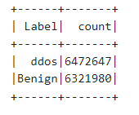
DataSet Preparation
Balanced Dataset
Data Cleaning
IP address and Flow ID columns have around 4500 distinct values and some columns are empty

Slide 14
Dataset Preparation
Data Cleaning
IP address and Flow ID columns have around 4500 distinct values and some columns are empty
Indexes are created for categorical features
Numerical columns are normalized.
A Single Vector is created for all the features.

Slide 15
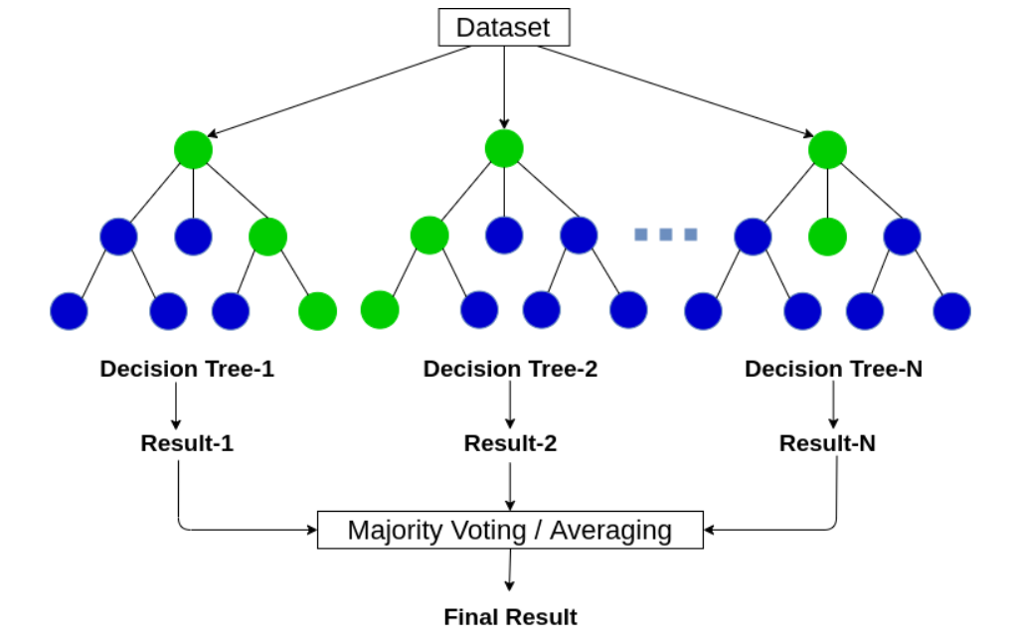
Random Forests Decision Tree
https://www.analyticsvidhya.com/blog/2020/05/decision-tree-vs-random-forest-algorithm/

Slide 16
RANDOM FORESTS DECISION TREE
Ensemble Learning
The process of combining the output of multiple individual models (also known as weak learners)
Ensembles of Decision Trees
Combining many decision trees in order to reduce the risk of overfitting.
Gini Impurity Index or Information Gain
The criteria for deciding feature importance
Limited subset of variables in each split
Parallel Training
Using both continuous and categorical features
Suitable for datasets with many outliers

Slide 17
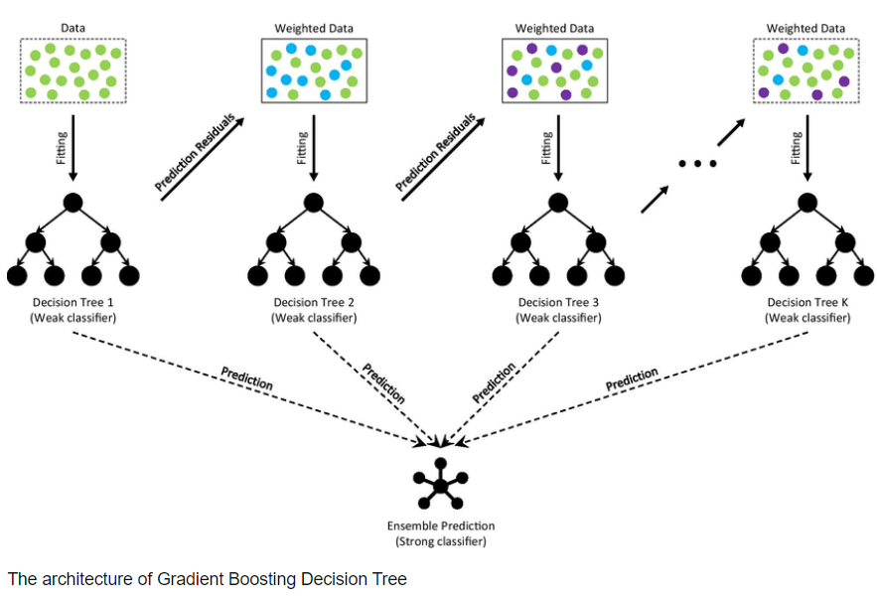
Gradient-Boosted Trees (GBTC)
https://www.researchgate.net/figure/The-architecture-of-Gradient-Boosting-Decision-Tree_fig2_356698772

Slide 18
Gradient-Boosted Trees (GBT)
Ensembles of Decision Trees
Iterative training of decision trees in order to minimize a loss function
Built in a stage-wise fashion
Usually Outperforms Random Forest
Selects variables that improve prediction accuracy with each new tree.
Sequential Training
Using both continuous and categorical features

Slide 19
Tuning Hyper Parameters
Random Forest
Gradient Boosted Tree
maxBins : 520
maxDepth: [5, 10]
maxIter: [5, 10]
minInfoGain: 0.0
impurity=variance
lossType= logistic
stepSize=0.1
featureSubsetStrategy: auto
subsamplingRate: 1.0
validation Tol=0.01
maxBins : 520
maxDepth: [10, 15]
numTrees: 20
minInfoGain: 0.0
Impurity: gini
featureSubsetStrategy: auto
subsamplingRate: 1.0
Bootstrap: True

Slide 20
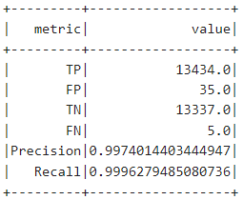
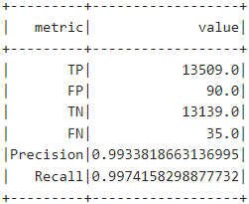
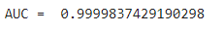
Evaluation Metrics
Random Forest
Gradient Boosted Tree

Slide 21
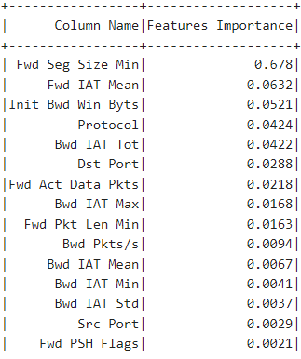
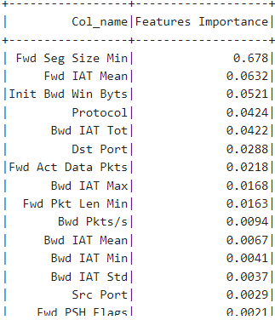
Feature Importance
Random Forest
Gradient Boosted Tree

Slide 22
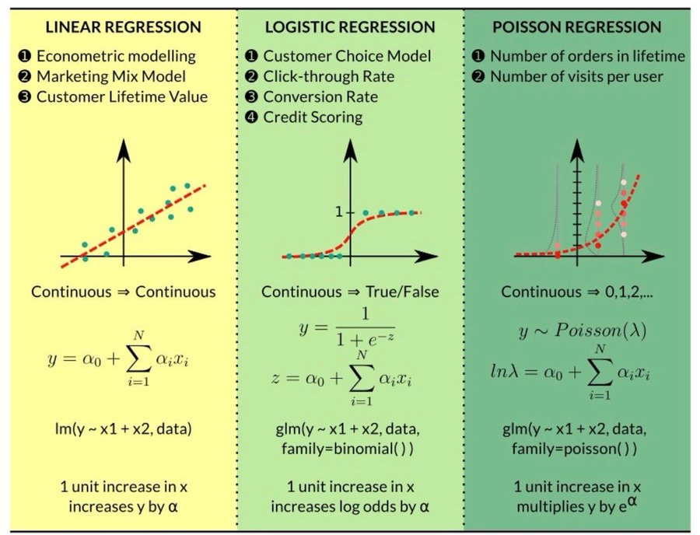
logistic regression

Slide 23
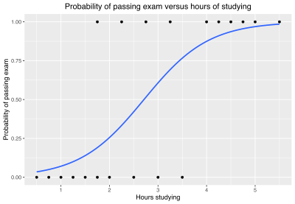
logistic regression
Example graph of a logistic regression curve fitted to data. The curve shows the probability of passing an exam (binary dependent variable) versus hours of studying (scalar independent variable).

Slide 24
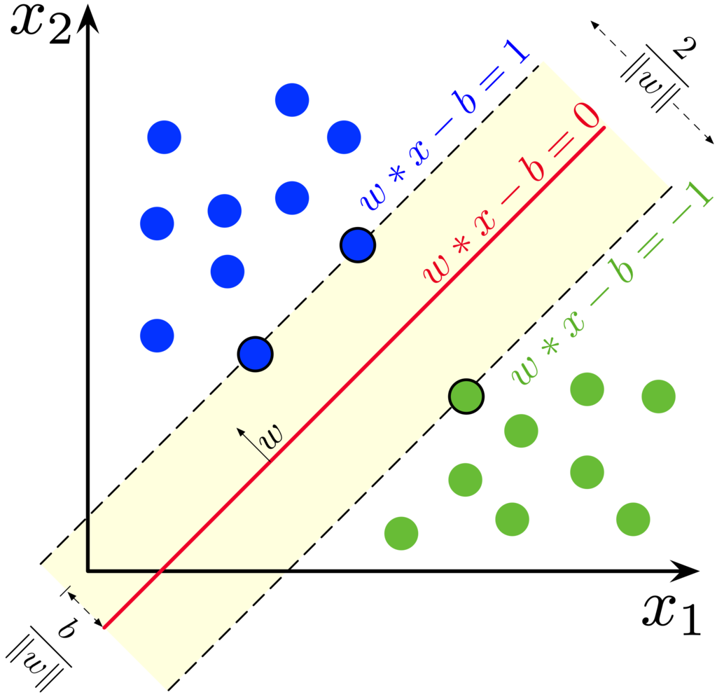
Linear support vector machine
Maximum-margin hyperplane and margins for an SVM trained with samples from two classes. Samples on the margin are called the support vectors.

Slide 25

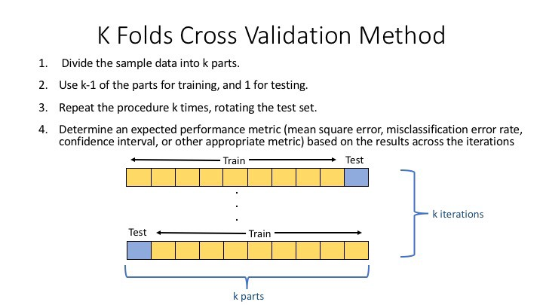
INTRODUCTION to cross validator and train split validation
Notes:
The data we use is typically split into training and test data. The training set contains a known output, and therefore the model learns on this data to be generalized to other data afterward.
Model validation is the process by which we make sure that our models can perform acceptably in “the present scenario.” In other terms, model validation allows you to predict how your model will perform on datasets not employed in training (model validation could be a big part of why preventing data leakage is so important). Model validation is vital because we don’t care how well the model predicts the data, we trained it. We already know the target values for the information we want to train a model, and in and of itself, it's way more important to think about how robust and capable a model is when tasked to model new datasets of the identical distribution and characteristics, but with different individual values from our training set. The primary sort of model validation introduced is typically called holdout validation, often considered the only style of cross-validation and thus the best to implement.

